Slide 1

Chapter 22
Network Layer:
Delivery, Forwarding,
and Routing
22.<number>
Copyright © The McGraw-Hill Companies, Inc. Permission required for reproduction or display.

Slide 2
Difference Between Delivery, Forwarding
and Routing
The network layer supervises the handling of the packets by the underlying physical networks. We define this handling as the delivery of a packet.
Delivery refers to the way a packet is handled by the underlying networks under the control of the network layer.
Forwarding refers to the way a packet is delivered to the next station.
Routing refers to the way routing tables are created to help in forwarding.
22.<number>

Slide 3

Figure 22.1 Direct and indirect delivery
22.<number>

Slide 4
22-2 FORWARDING
Forwarding means to place the packet in its route to its destination. Forwarding requires a host or a router to have a routing table. When a host has a packet to send or when a router has received a packet to be forwarded, it looks at this table to find the route to the final destination.
Topics discussed in this section:
Forwarding Techniques
Forwarding Process
Routing Table
22.<number>

Slide 5

Figure 22.2 Route method versus next-hop method
22.<number>

Slide 6

Figure 22.3 Host-specific versus network-specific method
22.<number>

Slide 7

Figure 22.4 Default method
22.<number>

Slide 8

Figure 22.5 Simplified forwarding module in classless address
22.<number>

Slide 9

Note
In classless addressing, we need at least four columns in a routing table.
22.<number>

Slide 10
Example 22.1
Make a routing table for router R1, using the configuration in Figure 22.6.
Solution
Table 22.1 shows the corresponding table.
22.<number>

Slide 11


Figure 22.6 Configuration for Example 22.1
m₃
22.<number>

Slide 12
Table 22.1 Routing table for router R1 in Figure 22.6
22.<number>

Slide 13
Example 22.2
Show the forwarding process if a packet arrives at R1 in Figure 22.6 with the destination address 180.70.65.140.
Solution
The router performs the following steps:
1. The first mask (/26) is applied to the destination address.
The result is 180.70.65.128, which does not match the
corresponding network address.
2. The second mask (/25) is applied to the destination
address. The result is 180.70.65.128, which matches the
corresponding network address. The next-hop address
and the interface number m0 are passed to ARP for
further processing.
22.<number>

Slide 14
Example 22.3
Show the forwarding process if a packet arrives at R1 in Figure 22.6 with the destination address 201.4.22.35.
Solution
The router performs the following steps:
1. The first mask (/26) is applied to the destination
address. The result is 201.4.22.0, which does not
match the corresponding network address.
2. The second mask (/25) is applied to the destination address. The result is 201.4.22.0, which does not match the corresponding network address (row 2).
22.<number>

Slide 15
Example 22.3 (continued)
3. The third mask (/24) is applied to the destination
address. The result is 201.4.22.0, which matches the
corresponding network address. The destination
address of the packet and the interface number m3 are
passed to ARP.
22.<number>

Slide 16
Example 22.4
Show the forwarding process if a packet arrives at R1 in Figure 22.6 with the destination address 18.24.32.78.
Solution
This time all masks are applied, one by one, to the destination address, but no matching network address is found. When it reaches the end of the table, the module gives the next-hop address 180.70.65.200 and interface number m2 to ARP. This is probably an outgoing package that needs to be sent, via the default router, to someplace else in the Internet.
22.<number>

Slide 17
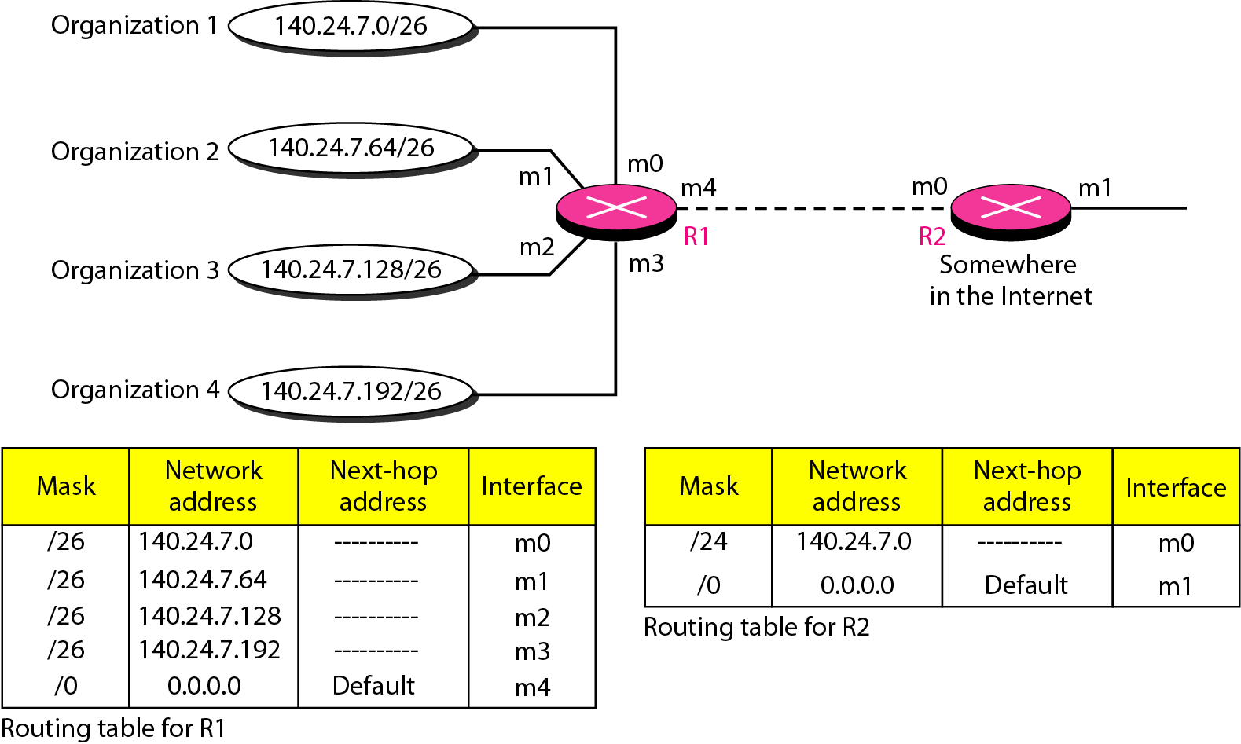
Figure 22.7 Address aggregation
22.<number>

Slide 18
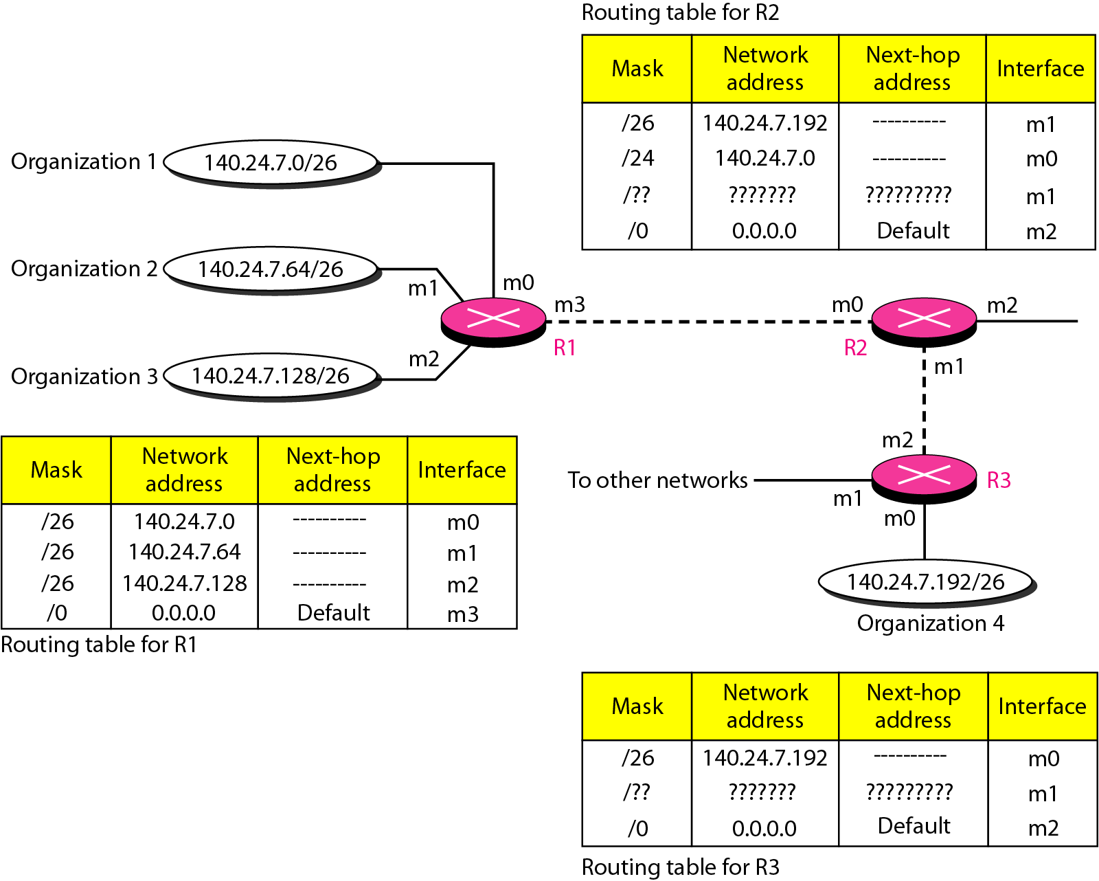
Figure 22.8 Longest mask matching
22.<number>

Slide 19
Example 22.5
As an example of hierarchical routing, let us consider Figure 22.9. A regional ISP is granted 16,384 addresses starting from 120.14.64.0. The regional ISP has decided to divide this block into four subblocks, each with 4096 addresses. Three of these subblocks are assigned to three
local ISPs; the second subblock is reserved for future use. Note that the mask for each block is /20 because the original block with mask /18 is divided into 4 blocks.
The first local ISP has divided its assigned subblock into 8 smaller blocks and assigned each to a small ISP. Each small ISP provides services to 128 households, each using four addresses.
22.<number>

Slide 20
Example 22.5 (continued)
The second local ISP has divided its block into 4 blocks and has assigned the addresses to four large organizations.
The third local ISP has divided its block into 16 blocks and assigned each block to a small organization. Each small organization has 256 addresses, and the mask is /24.
There is a sense of hierarchy in this configuration. All routers in the Internet send a packet with destination address 120.14.64.0 to 120.14.127.255 to the regional ISP.
22.<number>

Slide 21
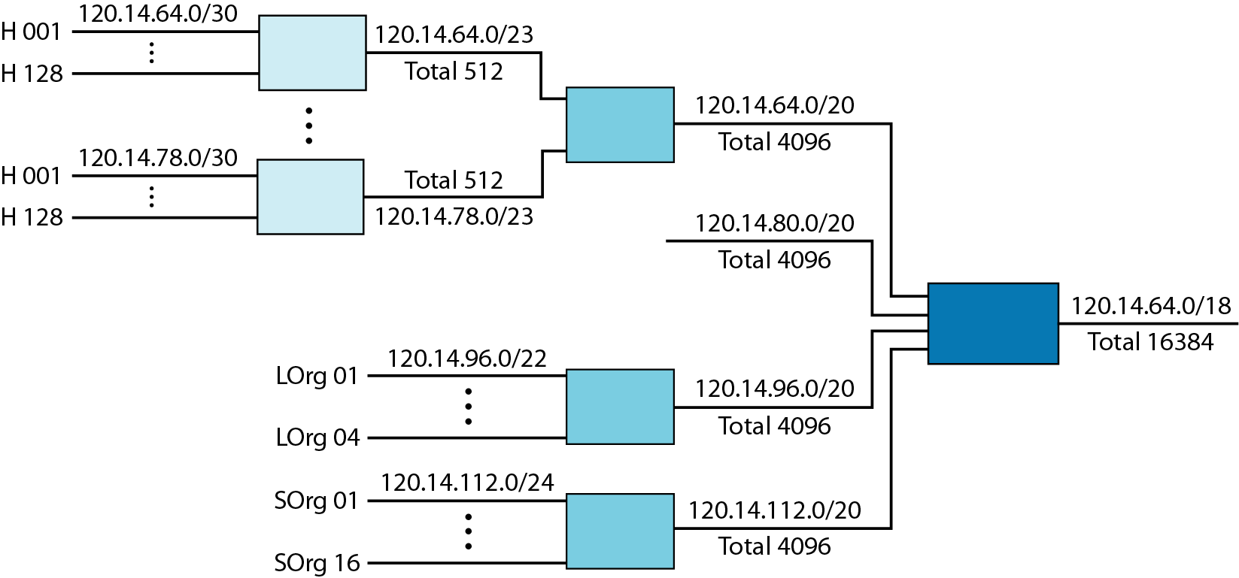
Figure 22.9 Hierarchical routing with ISPs
22.<number>

Slide 22
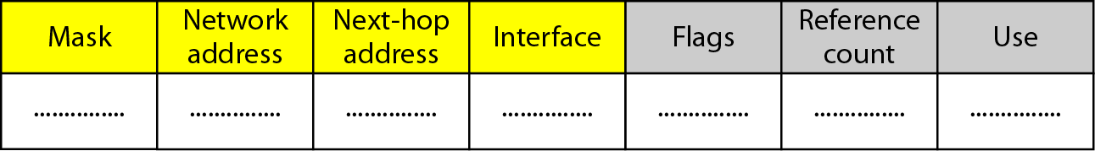
Figure 22.10 Common fields in a routing table
22.<number>

Slide 23
Example 22.6
One utility that can be used to find the contents of a routing table for a host or router is netstat in UNIX or LINUX. The next slide shows the list of the contents of a default server. We have used two options, r and n. The option r indicates that we are interested in the routing table, and the option n indicates that we are looking for numeric addresses. Note that this is a routing table for a host, not a router. Although we discussed the routing table for a router throughout the chapter, a host also needs a routing table.
22.<number>

Slide 24
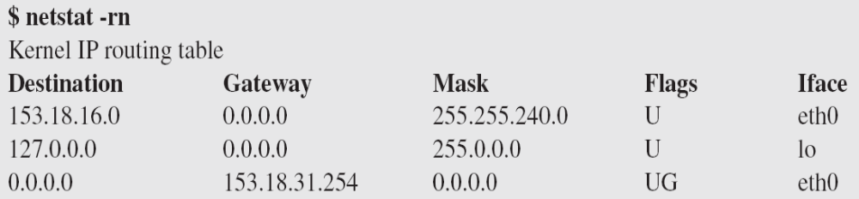
Example 22.6 (continued)
The destination column here defines the network address. The term gateway used by UNIX is synonymous with router. This column actually defines the address of the next hop. The value 0.0.0.0 shows that the delivery is direct. The last entry has a flag of G, which means that the destination can be reached through a router (default router). The Iface defines the interface.
22.<number>

Slide 25
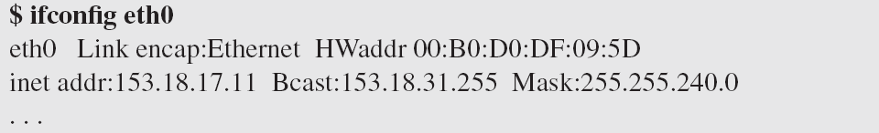
Example 22.6 (continued)
More information about the IP address and physical address of the server can be found by using the ifconfig command on the given interface (eth0).
22.<number>

Slide 26
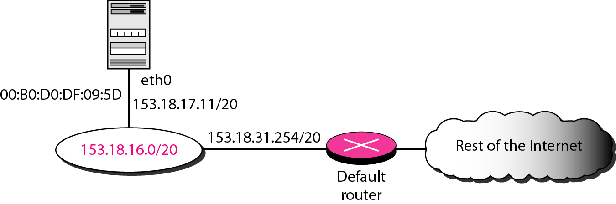
Figure 22.11 Configuration of the server for Example 22.6
22.<number>

Slide 27
UNICAST ROUTING PROTOCOLS
A routing table can be either static or dynamic. A static table is one with manual entries. A dynamic table is one that is updated automatically when there is a change somewhere in the Internet. A routing protocol is a combination of rules and procedures that lets routers in the Internet inform each other of changes.
Routing protocols have been created in response to the demand for dynamic routing tables.
It allows routers to share whatever they know about the internet or their neighborhood. The sharing of information allows a router in Ludhiana to know about the failure of a network in Amritsar. The routing protocols also include procedures for combining information received from other routers.
22.<number>

Slide 28

Figure 22.13 Popular routing protocols
22.<number>

Slide 29

One routing protocol cannot handle the task of updating the routing tables of all routers in internet. For this reason, an internet is divided into autonomous systems.
An autonomous system (AS) is a group of networks and routers under the authority of a single administration. Routing inside an autonomous system is referred to as intradomain routing. Routing between autonomous systems is referred to as interdomain routing.
Each autonomous system can choose one or more intradomain routing protocols to handle routing inside the autonomous system. However, only one interdomain routing protocol handles routing between autonomous systems
22.<number>

Slide 30




Figure 22.14 Distance vector routing tables
22.<number>

Slide 31

Figure 22.15 Initialization of tables in distance vector routing
22.<number>

Slide 32
Note
In distance vector routing, each node shares its routing table with its
immediate neighbors periodically and when there is a change.
22.<number>

Slide 33

Figure 22.16 Updation in distance vector routing
22.<number>

Slide 34

Figure 22.17 Two-node instability
1.PERIODIC UPDATE- 30 SECONDS
2. TRIGGERED UPDATE
6
X
22.<number>

Slide 35
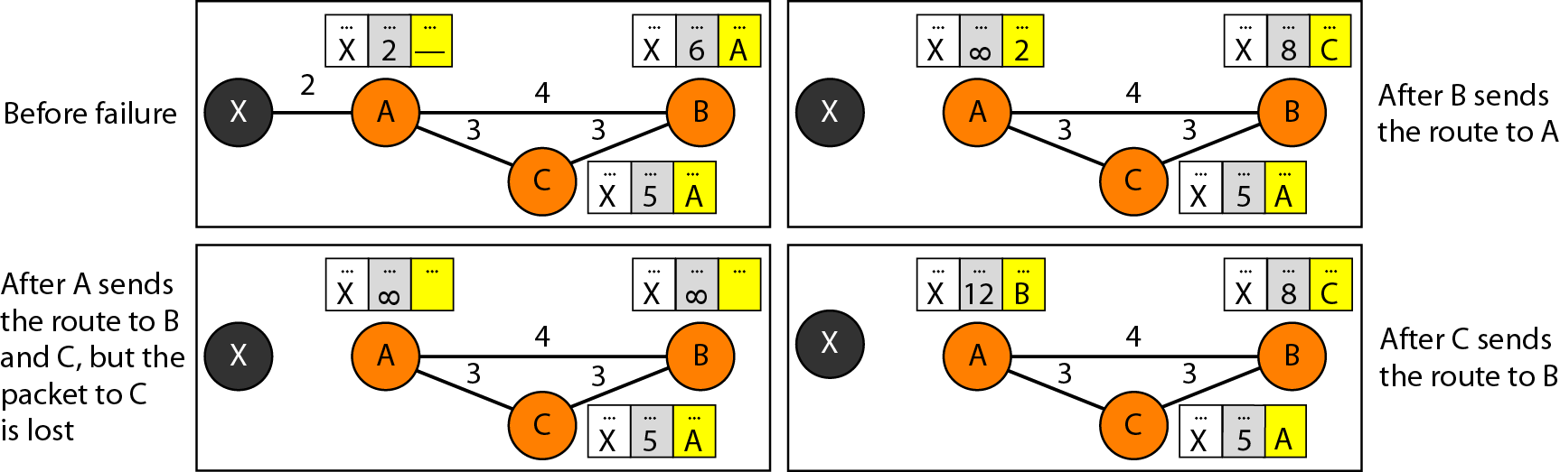
Figure 22.18 Three-node instability
22.<number>

Slide 36

Figure 22.19 Example of a domain using RIP
22.<number>

Slide 37

Figure 22.20 Concept of link state routing
22.<number>

Slide 38

Figure 22.21 Link state knowledge
Building the Routing Table
Link state packet
Flooding
Shortest path tree for each node
Calculation of routing table on the basis of shortest path tree
node identity, the list of links, a sequence number, and age
22.<number>

Slide 39
A router using a distance vector routing protocol does not have the knowledge of the entire path to a destination network.
Distance vector protocols use routers as sign posts along the path to the final destination.
The only information a router knows about a remote network is the distance or metric to reach that network and which path or interface to use to get there.
Distance vector routing protocols do not have an actual map of the network topology.
In contrast to distance vector routing protocol operation, a router configured with a link-state routing protocol can create a complete view or topology of the network by gathering information from all of the other routers.
22.<number>

Slide 40
To continue our analogy of sign posts, using a link-state routing protocol is like having a complete map of the network topology.
The sign posts along the way from source to destination are not necessary, because all link-state routers are using an identical map of the network.
A link-state router uses the link-state information to create a topology map and to select the best path to all destination networks in the topology.
RIP-enabled routers send periodic updates of their routing information to their neighbors.
Link-state routing protocols do not use periodic updates. After the network has converged, a link-state update is only sent when there is a change in the topology.
22.<number>

Slide 41

Figure 22.22 Dijkstra algorithm
22.<number>

Slide 42

Figure 22.23 Example of formation of shortest path tree
22.<number>

Slide 43

Table 22.2 Routing table for node A
22.<number>

Slide 44

Figure 22.24 Areas in an autonomous system
22.<number>

Slide 45
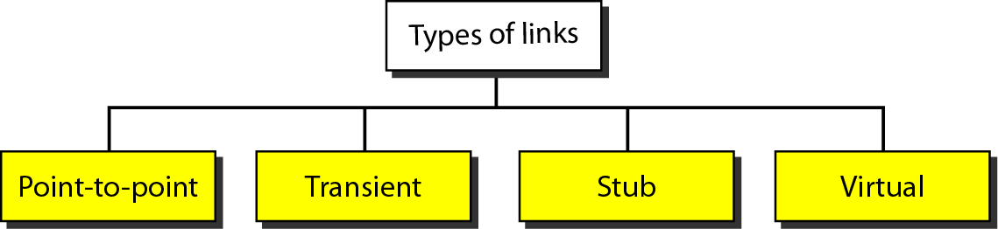
Figure 22.25 Types of links
22.<number>

Slide 46
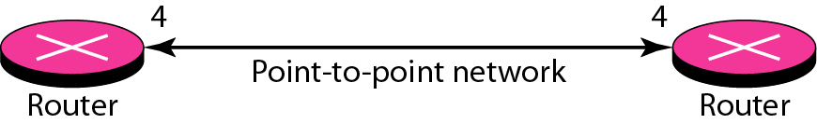
Figure 22.26 Point-to-point link
A point-to-point link connects two routers without any other host or router in between. In other words, the purpose of the link (network) is just to connect the two routers. An example of this type of link is two routers connected by a telephone line or a T line.
There is no need to assign a network address to this type of link. Graphically, the routers are represented by nodes, and the link is represented by a bidirectional edge connecting the nodes. The metrics, which are usually the same, are shown at the two ends, one for each direction. In other words, each router has only one neighbor at the other side of the link
22.<number>

Slide 47
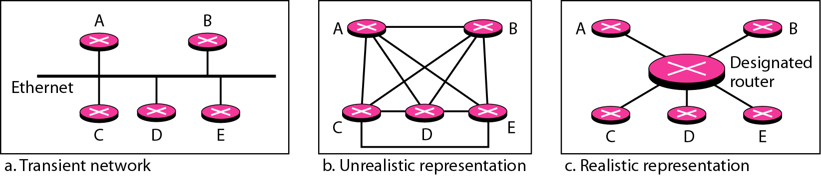
Figure 22.27 Transient link
A transient link is a network with several routers attached to it. The data can enter through any of the routers and leave through any router. All LANs and some WANs with two or more routers are of this type. In this case, each router has many neighbors.
For example, consider the Ethernet in Figure. Router A has routers B, C, D, and E as neighbors. Router B has routers A, C, D, and E as neighbors. If we want to show the neighborhood relationship in this situation.
22.<number>

Slide 48
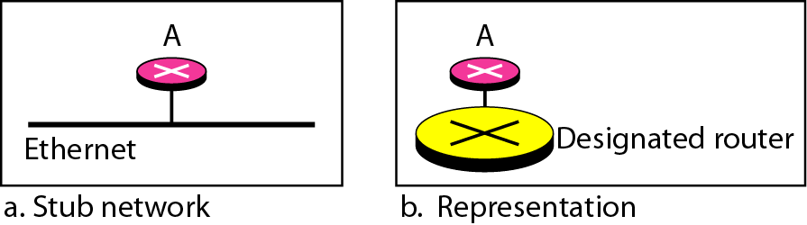
Figure 22.28 Stub link
A stub link is a network that is connected to only one router. The data packets enter the network through this single router and leave the network through this same router. This is a special case of the transient network. We can show this situation using the router as a node and using the designated router for the network. However, the link is only one-directional, from the router to the network
When the link between two routers is broken, the administration may create a virtual link between them, using a longer path that probably goes through several
routers.
22.<number>

Slide 49
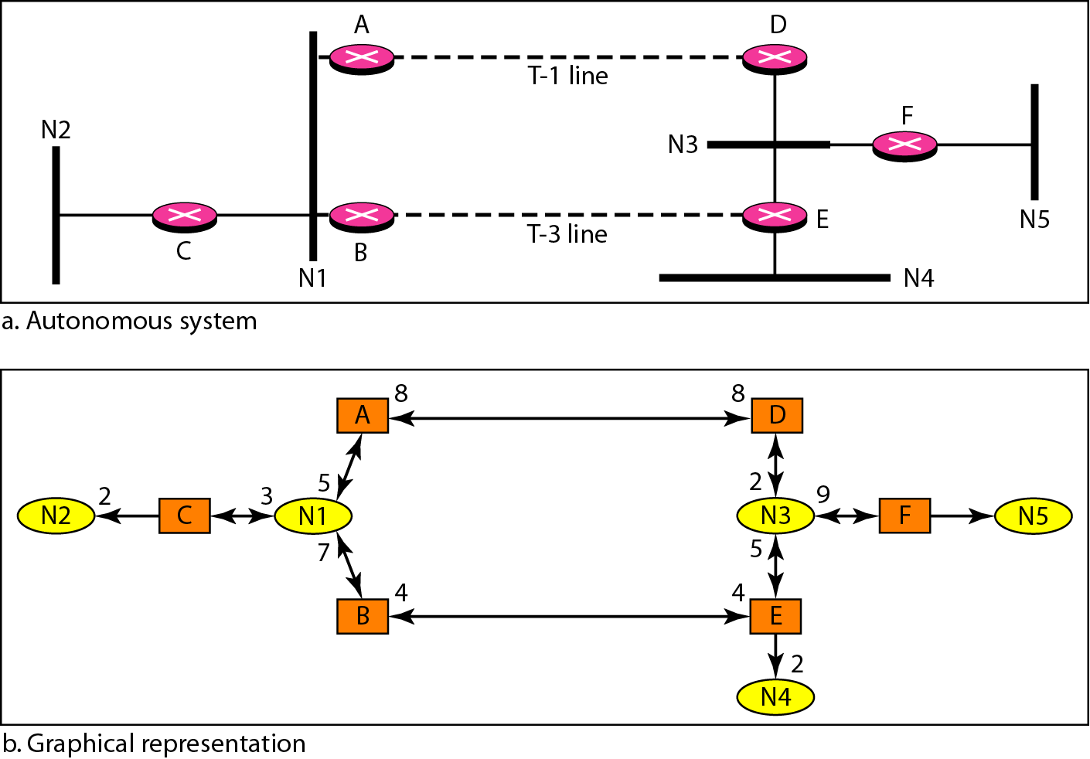
Figure 22.29 Example of an AS and its graphical representation in OSPF
22.<number>

Slide 50
Distance vector and link state routing are both intradomain routing protocols. They can be used inside an autonomous system, but not between autonomous systems.
These two protocols are not suitable for interdomain routing mostly because of scalability. Both of these routing protocols become intractable when the domain of operation becomes large.
Distance vector routing is subject to instability if there are more than a few hops in the domain of operation.
Link state routing needs a huge amount of resources to calculate routing tables. It also creates heavy traffic because of flooding.
22.<number>

Slide 51
There is a need for a third routing protocol which we call path vector routing. Path vector routing proved to be useful for interdomain routing.
The principle of path vector routing is similar to that of distance vector routing.
In path vector routing, we assume that there is one node (there can be more, but one is enough for our conceptual discussion) in each autonomous system that acts on behalf of the entire autonomous system.
Speaker node. The speaker node in an AS creates a routing table and advertises it to speaker nodes in the neighboring ASs.
The idea is the same as for distance vector routing except that only speaker nodes in each AS can communicate with each other.
However, what is advertised is different. A speaker node advertises the path, not the metric of the nodes, in its autonomous system or other autonomous systems.
22.<number>

Slide 52
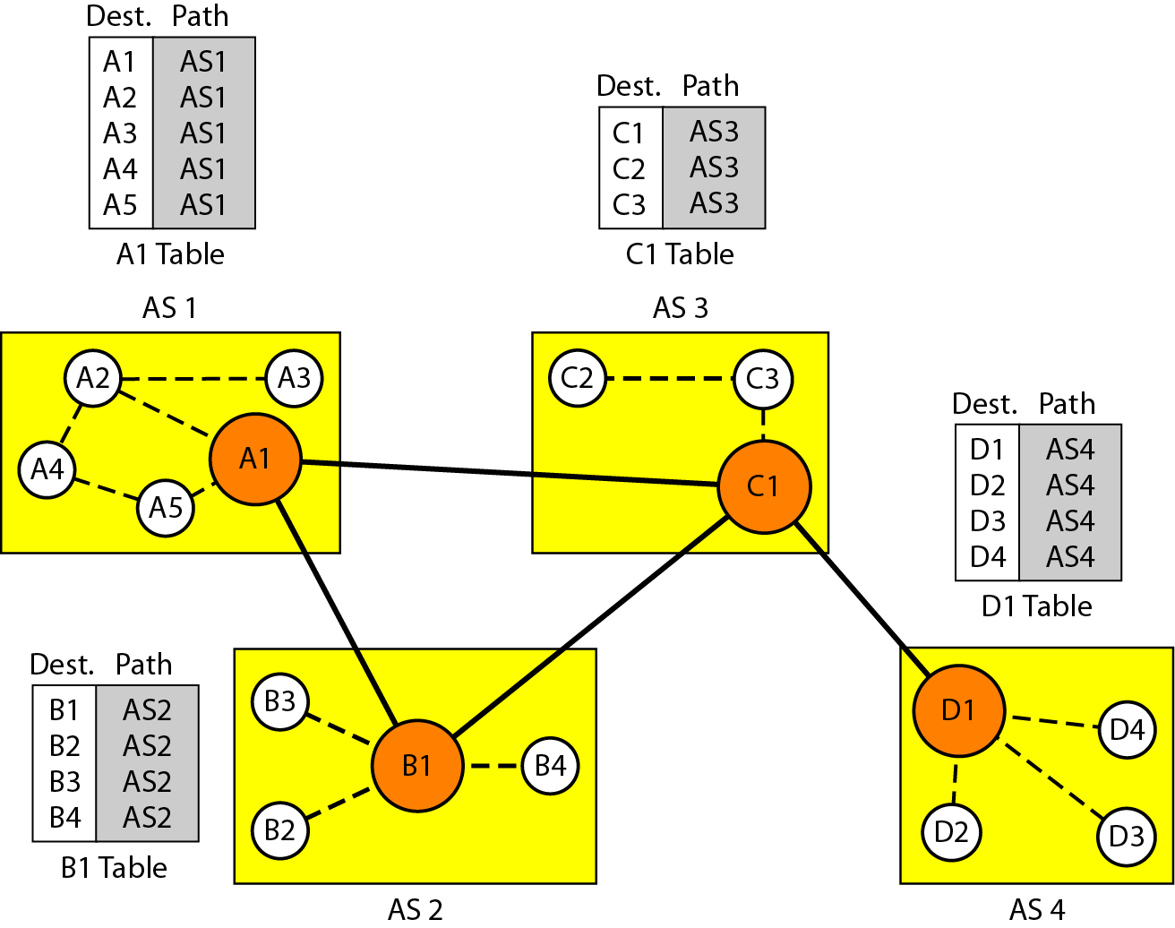
Figure 22.30 Initial routing tables in path vector routing
22.<number>

Slide 53
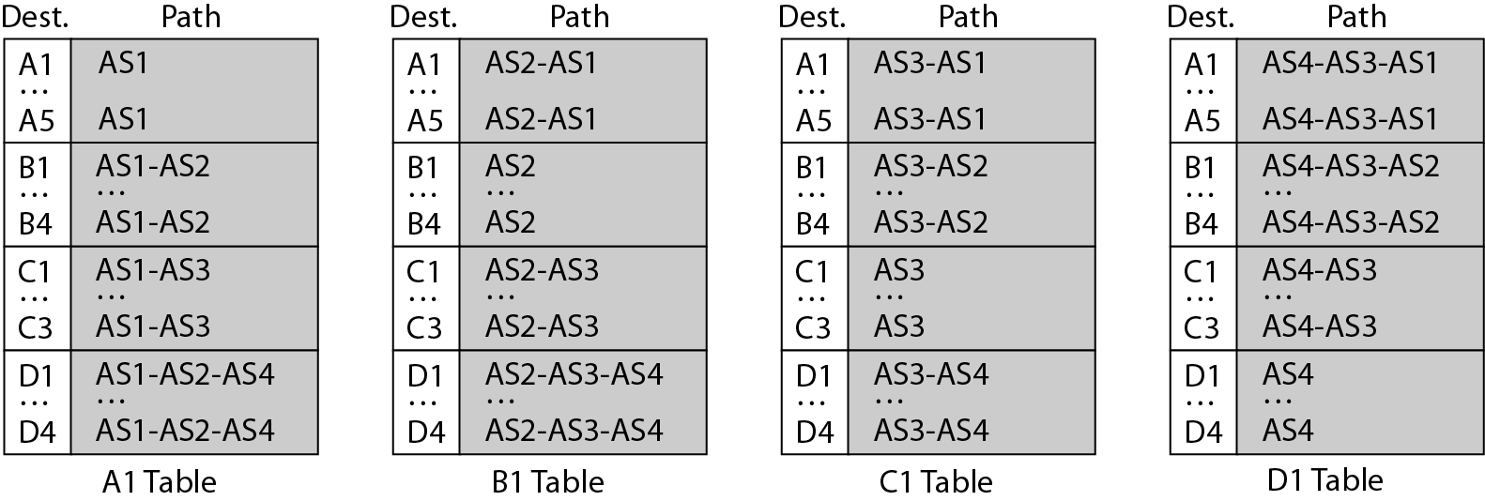
Figure 22.31 Stabilized tables for three autonomous systems
Loop problem is absent
Policy routing
Optimum Path
22.<number>

Slide 54
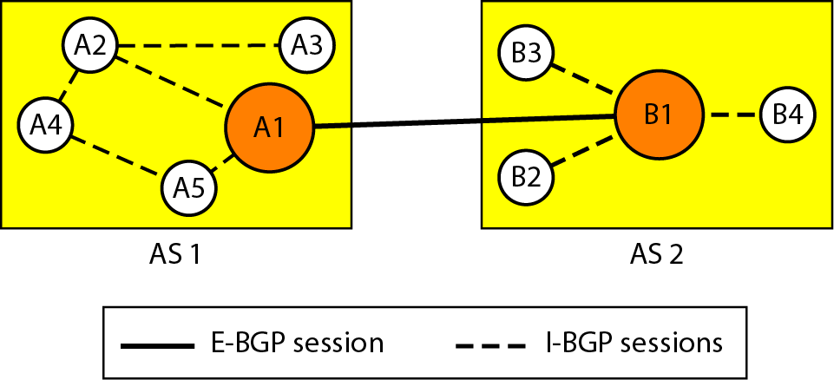
Figure 22.32 Internal and external BGP sessions
BGP- Border Gateway Protocol- Interdomain Protocol using path vector routing
Stub AS: data connection between two AS only. Data can not be just passed
through it.
Multihomed AS: There is more than one connection to other AS, Data can not be just passed
through it.
Transit AS:Data can pass through it. ISP
AS3
22.<number>

Slide 55
PATH ATTRIBUTES
1.Well Known
(i) Mandatory, must appear in route description
(ii) Discretionary, recognized by every router, but it is not included in every updation
2. Optional
(i) Transitive- Must be passed from one router to another router that has not implemented the attribute
(ii) Non-Transitive, discard
22.<number>

Slide 56
22-4 MULTICAST ROUTING PROTOCOLS
In this section, we discuss multicasting and multicast routing protocols.
Topics discussed in this section:
Unicast, Multicast, and Broadcast
Applications
Multicast Routing
Routing Protocols
22.<number>

Slide 57
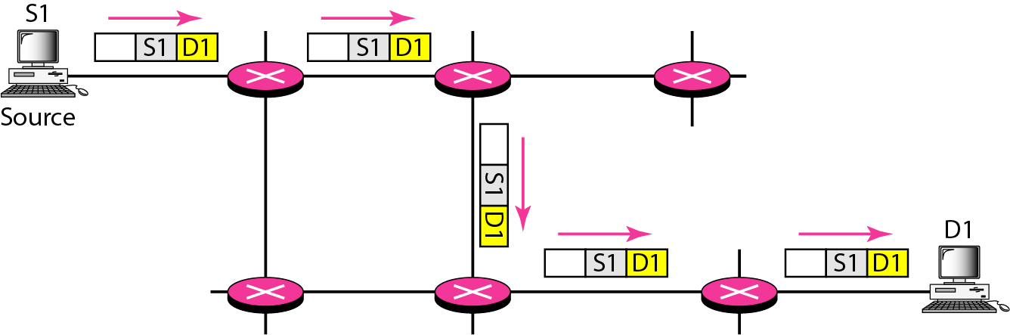
Figure 22.33 Unicasting
22.<number>

Slide 58
Note
In unicasting, the router forwards the received packet through
only one of its interfaces.
22.<number>

Slide 59
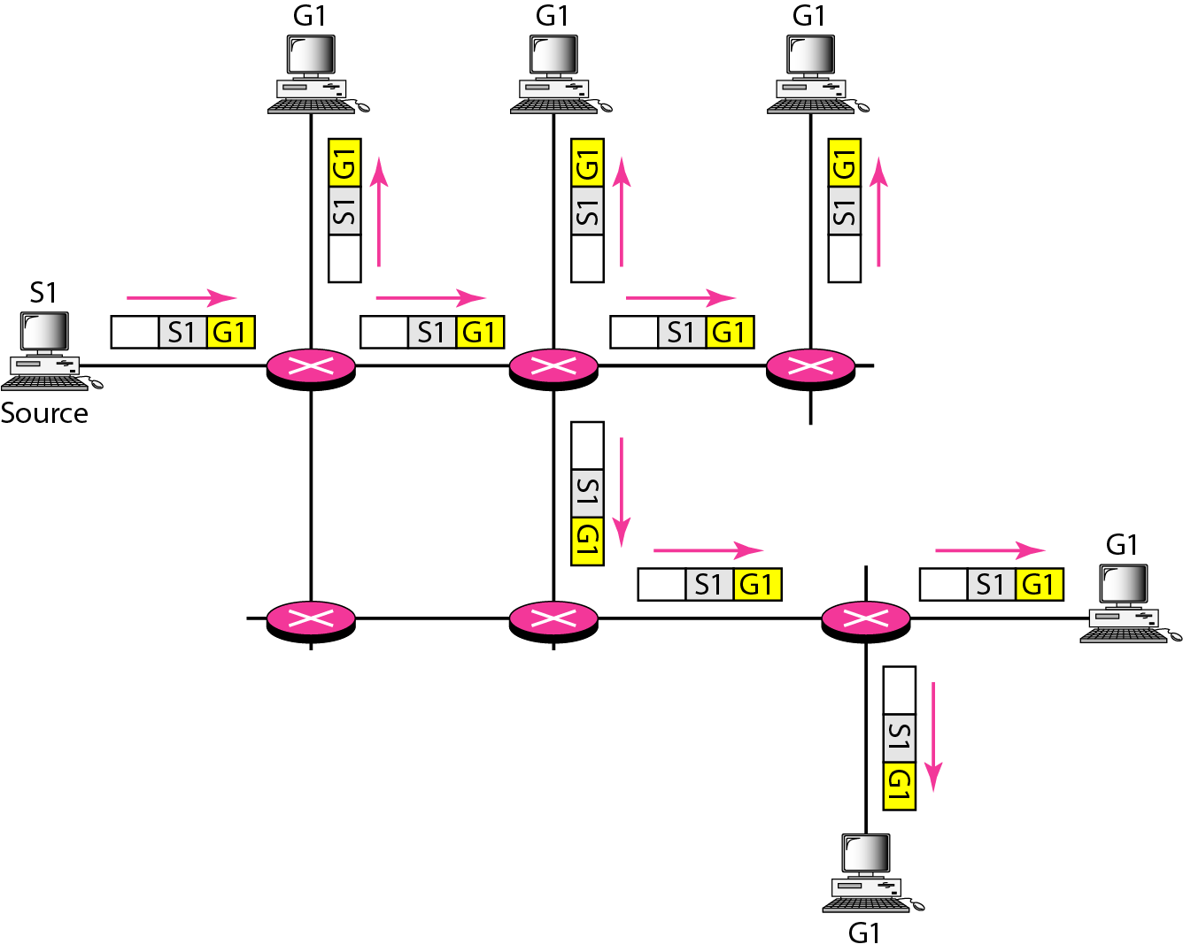
Figure 22.34 Multicasting
22.<number>

Slide 60
Note
In multicasting, the router may
forward the received packet
through several of its interfaces.
22.<number>

Slide 61
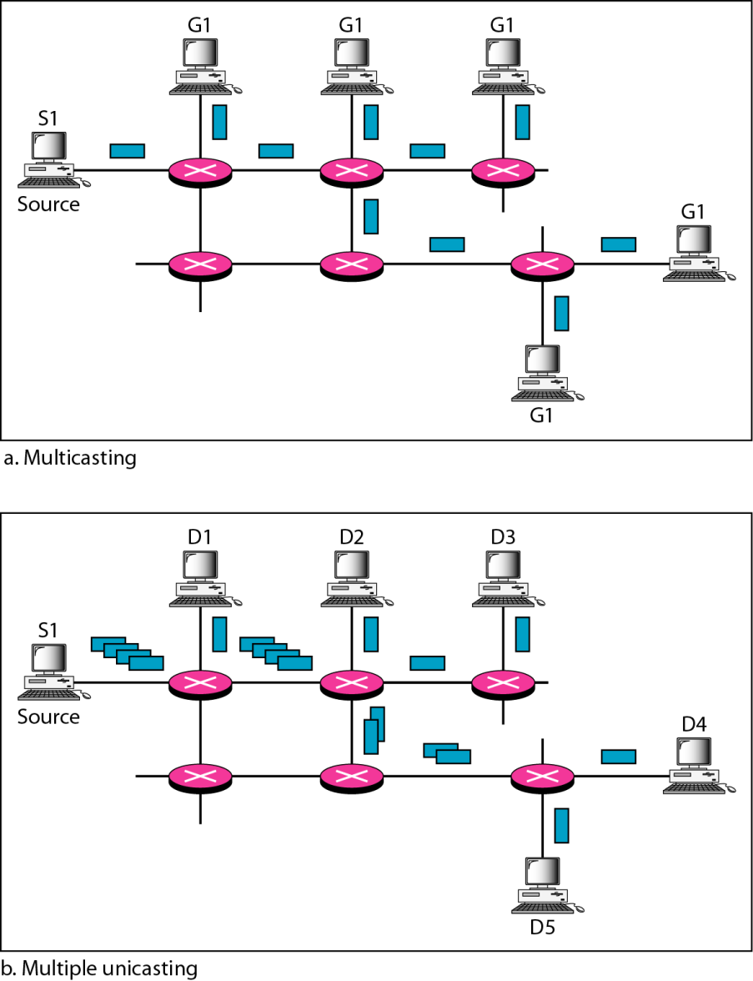
Figure 22.35 Multicasting versus multiple unicasting
22.<number>

Slide 62
Note
Emulation of multicasting through multiple unicasting is not efficient
and may create long delays,
particularly with a large group.
22.<number>

Slide 63
Note
In unicast routing, each router in the domain has a table that defines
a shortest path tree to possible destinations.
22.<number>

Slide 64
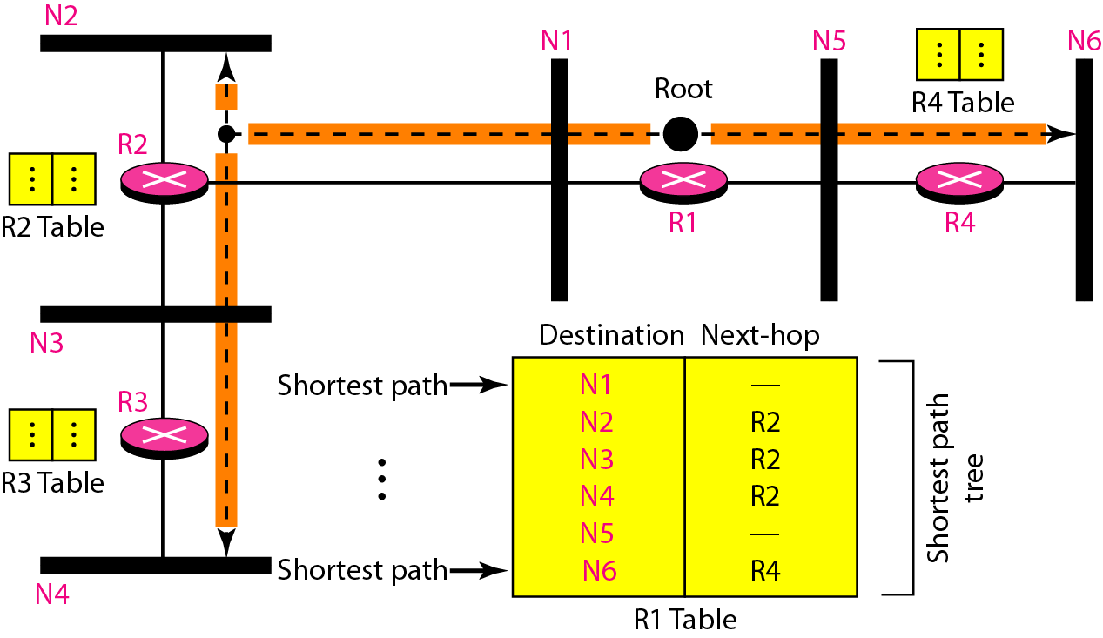
Figure 22.36 Shortest path tree in unicast routing
22.<number>

Slide 65
Note
In multicast routing, each involved router needs to construct
a shortest path tree for each group.
22.<number>

Slide 66
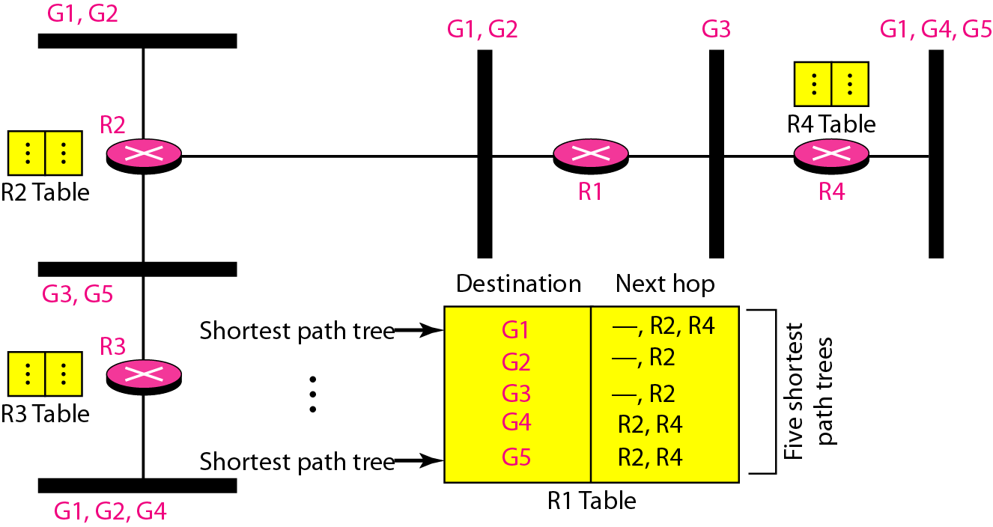
Figure 22.37 Source-based tree approach
22.<number>

Slide 67
Note
In the source-based tree approach, each router needs to have one shortest path tree for each group.
22.<number>

Slide 68
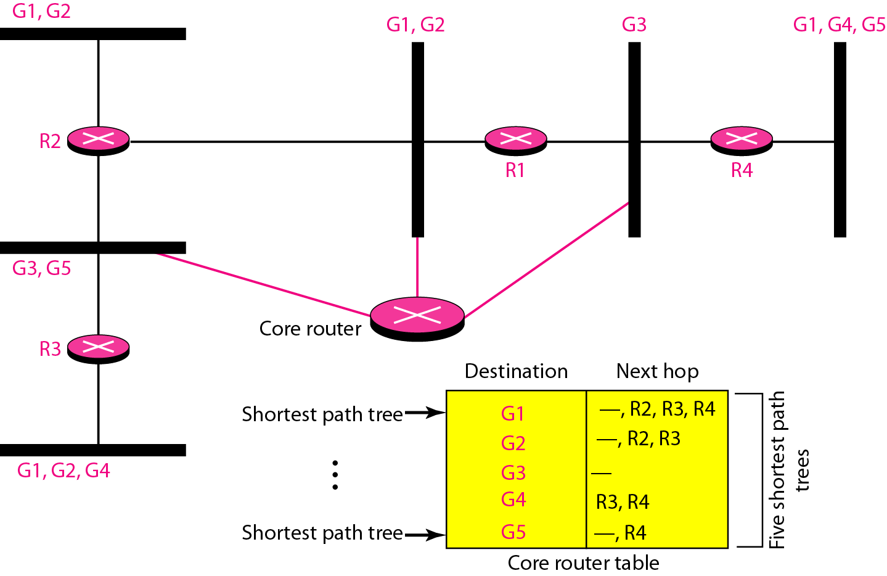
Figure 22.38 Group-shared tree approach
22.<number>

Slide 69
Note
In the group-shared tree approach, only the core router, which has a shortest path tree for each group, is involved in multicasting.
22.<number>

Slide 70
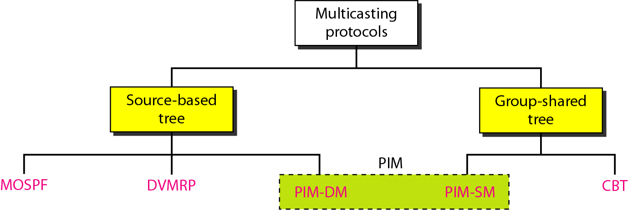
Figure 22.39 Taxonomy of common multicast protocols
22.<number>

Slide 71
Note
Multicast link state routing uses the source-based tree approach.
22.<number>

Slide 72
Note
Flooding broadcasts packets, but creates loops in the systems.
22.<number>

Slide 73
Note
RPF eliminates the loop in the
flooding process.
22.<number>

Slide 74
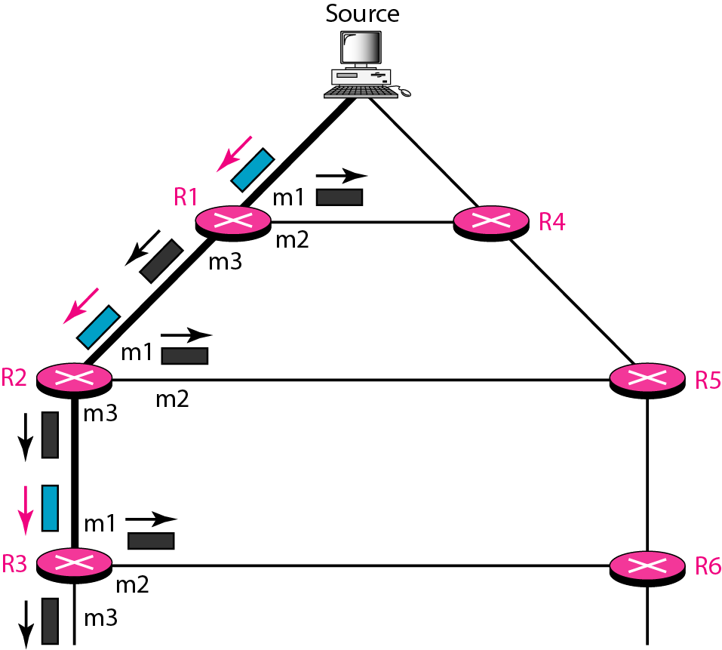
Figure 22.40 Reverse path forwarding (RPF)
22.<number>

Slide 75
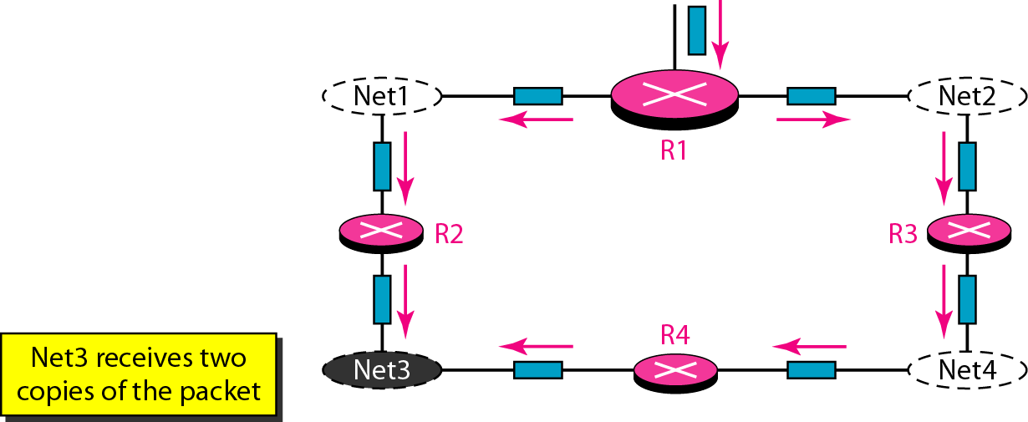
Figure 22.41 Problem with RPF
22.<number>

Slide 76
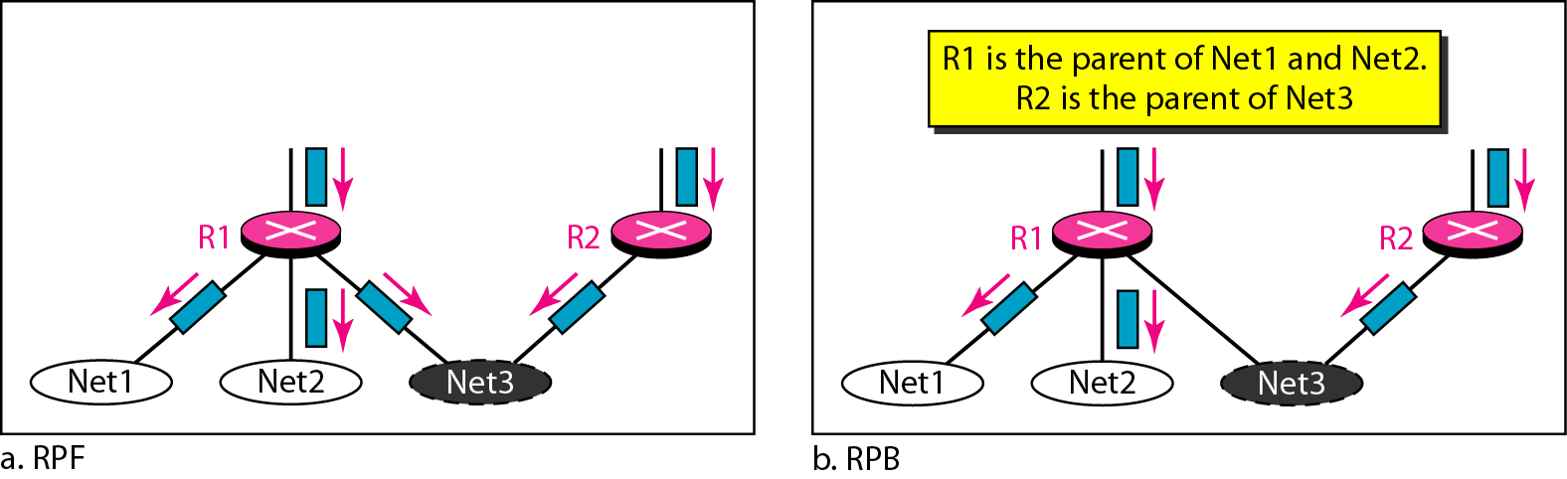
Figure 22.42 RPF Versus RPB
22.<number>

Slide 77
Note
RPB creates a shortest path broadcast tree from the source to each destination.
It guarantees that each destination receives one and only one copy
of the packet.
22.<number>

Slide 78
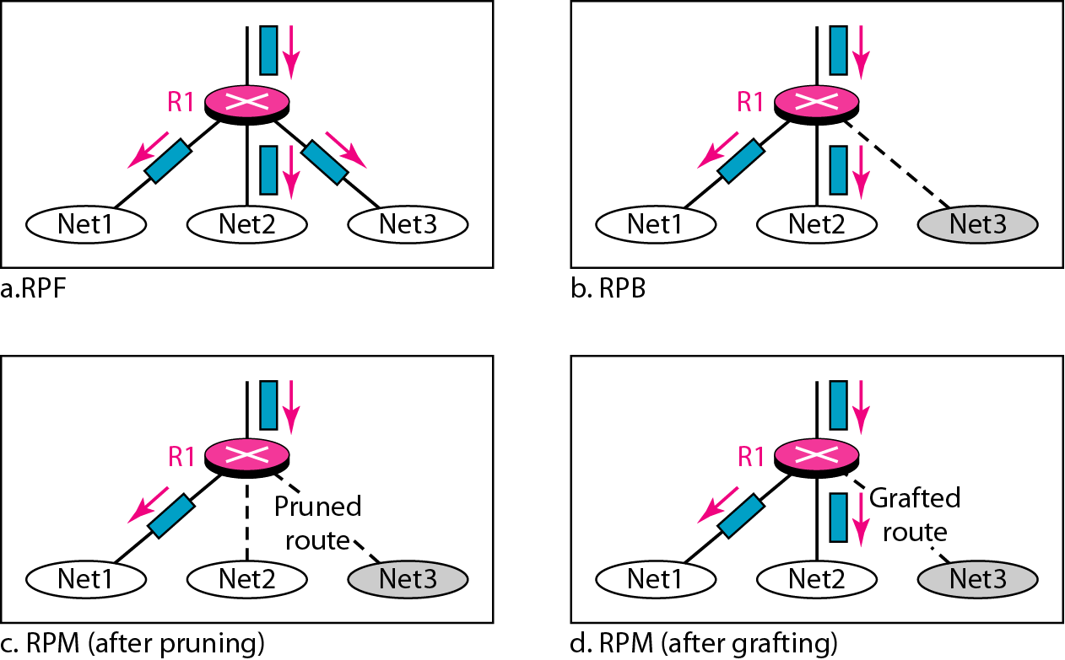
Figure 22.43 RPF, RPB, and RPM
22.<number>

Slide 79
Note
RPM adds pruning and grafting to RPB to create a multicast shortest
path tree that supports dynamic membership changes.
22.<number>

Slide 80
Core-Based Tree (CBT) is a group-shared tree, center-based protocol using one tree per group. One of the routers in the tree is called the core.
The autonomous system is divided into regions, and a core (center
router or rendezvous router) is chosen for each region.
22.<number>

Slide 81
Formation of the Tree: After the rendezvous point is selected, every router is informed of the unicast address of the selected router.
Each router then sends a unicast join message (similar to a grafting message) to show that it wants to join the group.
This message passes through all routers that are located between the sender and the rendezvous router.
Each intermediate router extracts the necessary information from the message, such as the unicast address of the sender and the interface through which the packet has arrived, and
forwards the message to the next router in the path.
When the rendezvous router has received all join messages from every member of the group, the tree is formed.
22.<number>

Slide 82
Now every router knows its upstream router (the router that leads to the root) and the downstream router (the router that leads to the leaf).
If a router wants to leave the group, it sends a leave message to its upstream router.
The upstream router removes the link to that router from the tree and forwards the message to its upstream router, and so on.
22.<number>

Slide 83
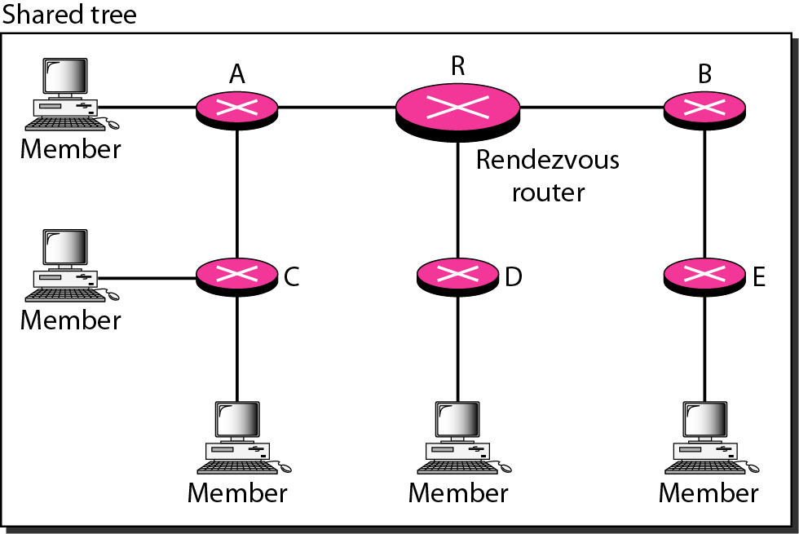
Figure 22.44 Group-shared tree with rendezvous router
CORE BASED TREE
22.<number>

Slide 84
The Core-Based Tree (CBT) protocol is a group-shared protocol that uses a core as the root of the tree. A packet is sent from the source to members of the group following this procedure:
The source, which may or may not be part of the tree, encapsulates the multicast packet inside a unicast packet with the unicast destination address of the core and sends it to the core.
2. This part of delivery is done using a unicast address; the only recipient is the core router.
3. The core decapsulates the unicast packet and forwards it to all interested interfaces.
4. Each router that receives the multicast packet, in tum, forwards it to all interested interfaces.
22.<number>

Slide 85
Sending Multicast Packets After formation of the tree, any source (belonging to the group or not) can send a multicast packet to all members of the group.
It simply sends the packet to the rendezvous router, using the unicast address of the rendezvous router; the rendezvous router distributes the packet to all members of the group.
Figure shows how a host can send a multicast packet to all members of the group.
Note that the source host can be any of the hosts inside the shared tree or any host outside the shared tree.
In Figure we show one located outside the shared tree.
22.<number>

Slide 86
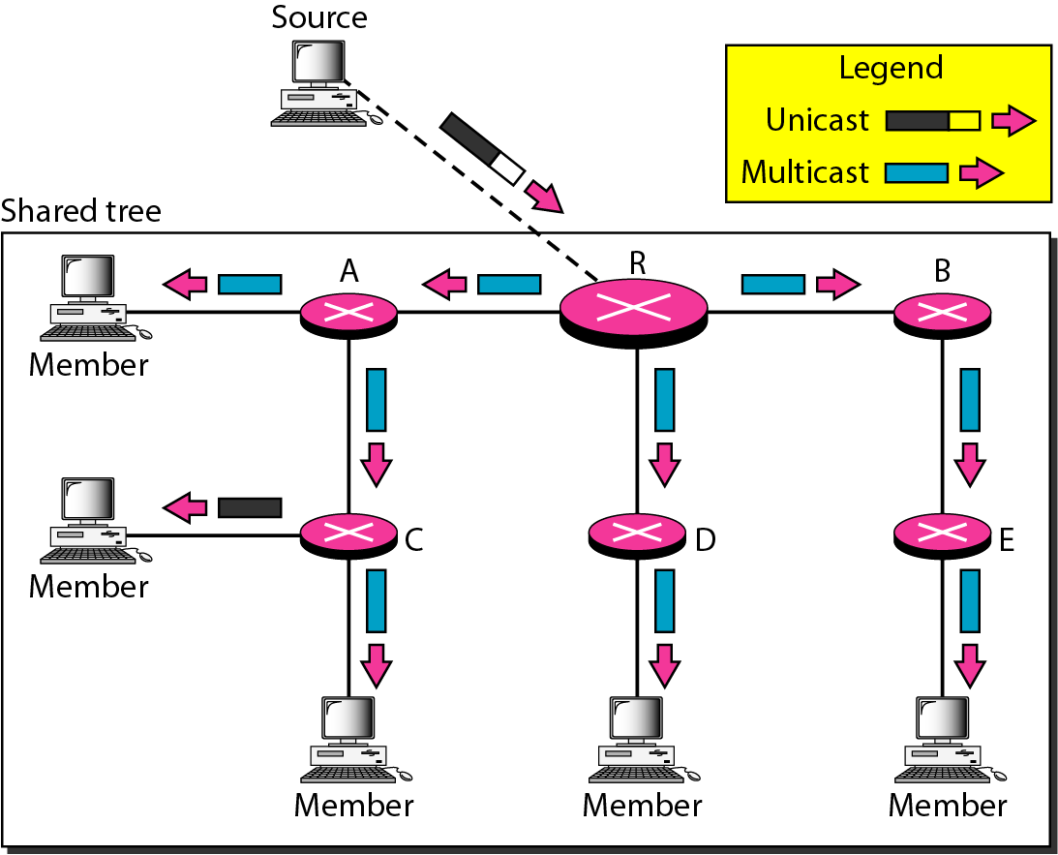
Figure 22.45 Sending a multicast packet to the rendezvous router
22.<number>

Slide 87
Note
In CBT, the source sends the multicast packet (encapsulated in a unicast packet) to the core router. The core router decapsulates the packet and forwards it to all interested interfaces.
22.<number>

Slide 88
Note
PIM-DM is used in a dense multicast environment, such as a LAN.
22.<number>

Slide 89
PIM
Protocol Independent Multicast (PIM) is the name given to two independent multicast routing protocols:
Protocol Independent Multicast, Dense Mode (PIM-DM) and
Protocol Independent Multicast, Sparse Mode (PIM-SM).
Both protocols are unicastprotocol- dependent, but the similarity ends here.
PIM-DM is used when there is a possibility that each router is involved in multicasting (dense mode).
In this environment, the use of a protocol that broadcasts the packet is justified because almost all routers are involved in the process.
22.<number>

Slide 90
PIM-DM is a source-based tree routing protocol that uses RPF and pruning/grafting strategies for multicasting.
Its operation is like that of DVMRP; however, unlike DVMRP, it does not depend on a specific unicasting protocol.
It assumes that the autonomous system is using a unicast protocol and each router has a table that can find the outgoing interface that has an optimal path to a destination.
This unicast protocol can be a distance vector protocol (RIP) or link state protocol (OSPF).
22.<number>

Slide 91
PIM-SM
PIM-SM is used when there is a slight possibility that each router is involved in multicasting (sparse mode).
In this environment, the use of a protocol that broadcasts the packet is not justified; a protocol such as CBT that uses a group-shared tree is more appropriate.
PIM-SM is a group-shared tree routing protocol that has a rendezvous point (RP) as the source of the tree.
Its operation is like CBT; however, it is simpler because it does
not require acknowledgment from a join message.
In addition, it creates a backup set of RPs for each region to cover RP failures.
22.<number>

Slide 92
One of the characteristics of PIM-SM is that it can switch from a group-shared tree strategy to a source-based tree strategy when necessary.
This can happen if there is a dense area of activity far from the RP.
That area can be more efficiently handled with a source-based tree strategy instead of a group-shared tree strategy.
22.<number>

Slide 93
Note
PIM-DM uses RPF and pruning/ grafting strategies to handle multicasting.
However, it is independent of the underlying unicast protocol.
22.<number>

Slide 94
Note
PIM-SM is used in a sparse multicast environment such as a WAN.
22.<number>

Slide 95
Note
PIM-SM is similar to CBT but uses a simpler procedure.
22.<number>

Slide 96
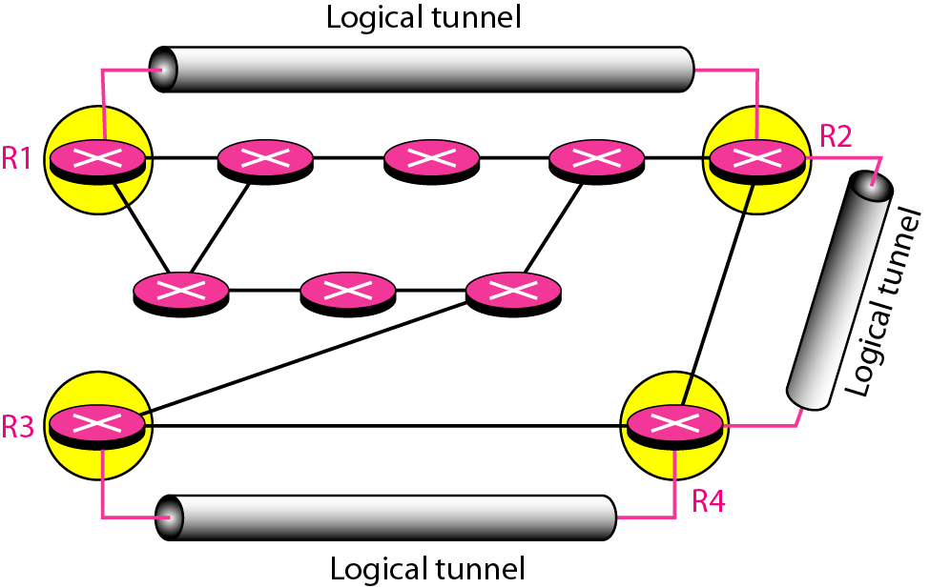
Figure 22.46 Logical tunneling
22.<number>

Slide 97
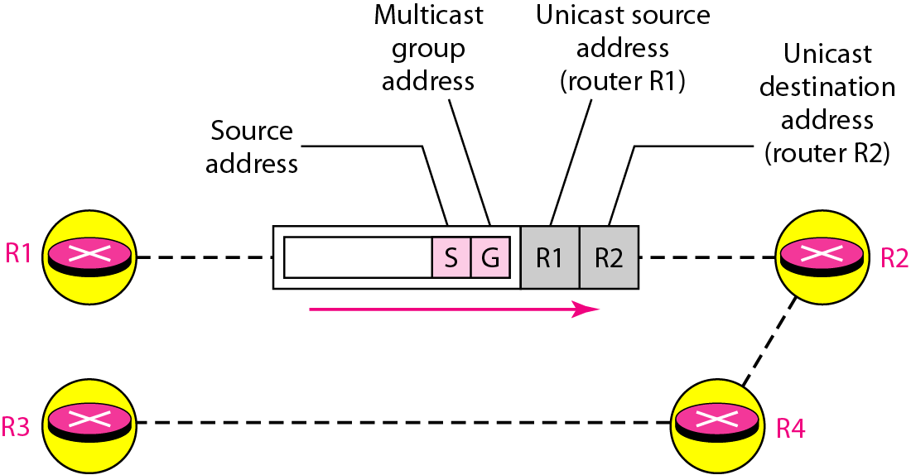
MBONE
22.<number>

